Slide 1

STUDENT RECORD SYSTEM

Slide 2

POWER POINT PRESENTATION ON STUDENT RECORD SYSTEM Website using PHP MYSQL MAJOR PROJECT SUBMITTED IN PARTIAL FULFILLMENT OF THE REQUIREMENTS FOR THE DEGREE OF BACHELOR OF COMPUTER APPLICATION

Slide 3
GROUP MEMBER
NAME : SUBHADIP ROY
ROLL NO : 35101220024
REGISTRATION NO. : 203511001210022
TOPIC NAME : STUDENT RECORD SYSTEM

Slide 4
CONTENTS
INTRODUCTION
OBJECTIVES
TECHNOLOGY USED
DESCRIPTION OF EACH MODULES
HOME PAGE, SIGNUP & SIGNIN PAGE
ADMIN DASHBOARD
STUDENT DASHBOARD
DFD(0 LEVEL)
DFD(1 LEVEL)
DFD(2 LEVEL)
ERD(ENTITY RELATIONSHIP DIAGRAM)
FUTURE SCOPE
CONCLUSION

Slide 5

INTRODUCTION
In this project pertinent to the setting up of a automated student record system which enables the users of a college like student and faculty to access the important information with ease through a user friendly web application. This proposed system aims at eliminating the practice of time-consuming and vulnerable tradition of manual maintenance of student information in paper at the very basic level. In a college there are many departments all these departments provide various records regarding students. Most of these track records need to maintain information about the students. Thus, by proposing a computerized student record system will enable the users to access data at any time and any place. The student web portal enables huge storage of data and easy retrieval. There are many departments in a college thus but introducing a student web portal will centralize the administration and the entire system will work as one single entity. The paper work would be reduced and number of workers in each department staff also reduces as one single operator can run this web application

Slide 6
OBJECTIVES
A flexible web-based record system allows you to go through an ordered way to store students’ data on an as-needed basis. Following are the main objectives:-
1) Online registration of students reduces the headache of paper work and makes free of storing physical files.
2) Maintenance of student records are easier and faster.
3) High Quality
4)Can be accessible from any where and any time.
5) To considerably save time, energy and money

Slide 7
TECHNOLOGY USED
FRONT-END:
HTML: HTML is an acronym which stands for Hyper Text Markup Language which is used for creating web pages and web applications.
CSS: Cascading Style Sheets, fondly referred to as CSS, is a simple design language intended to simplify the process of making web pages presentable.CSS handles the look and feel part of a web page.
BOOTSTRAP : Bootstrap is a free and open-source front-end framework for designing websites and web applications. It contains HTML and CSS based design templates for typography, forms, buttons, navigation and others.
JAVASCRIPT : JavaScript, often abbreviated as JS, is a high-level, interpreted programming language. It is a language which is also characterized as dynamic, weakly typed, prototype-based and multi-paradigm.
AJAX : AJAX stands for Asynchronous JavaScript and XML. It is a set of web development to build more responsive websites and applications.

Slide 8
TECHNOLOGY USED
BACK-END:
PHP : PHP (recursive acronym for PHP: Hypertext Preprocessor). PHP is a server-side scripting language embedded in HTML in its simplest form.
DATABASE:
MySQL:MySQL is a relational database management system. A relational database stores data in separate tables rather than putting all the data in one big storeroom. The database structure is organized into physical files optimized for speed.
SERVER USED:
Apache : The Apache HTTP Server is a web server software notable for playing a key role in the initial growth of the World Wide Web.
SOFTWARE USED:
VS CODE : Visual Studio Code combines the simplicity of a source code editor with powerful developer tooling, like IntelliSense code completion and debugging.

Slide 9
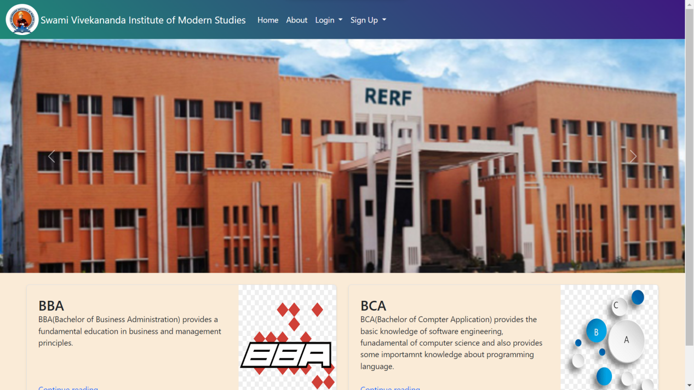
DESCRIPTION OF MODULES
Without Registration:
Home:–
This module contains all the links of the application such as Home, Login, Sign Up
and About page

Slide 10
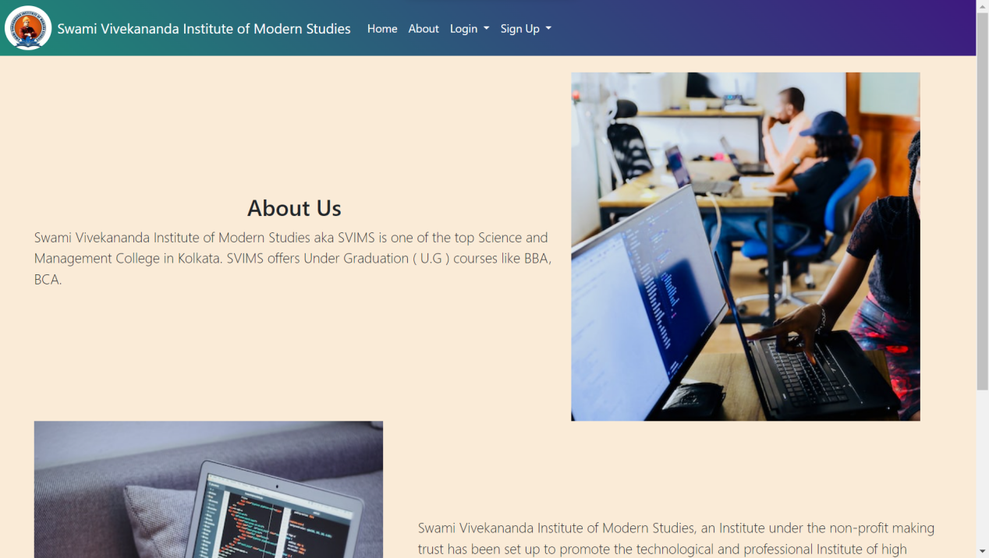
About page:-
This page describes briefly about the institutation and the courses it offfers.

Slide 11
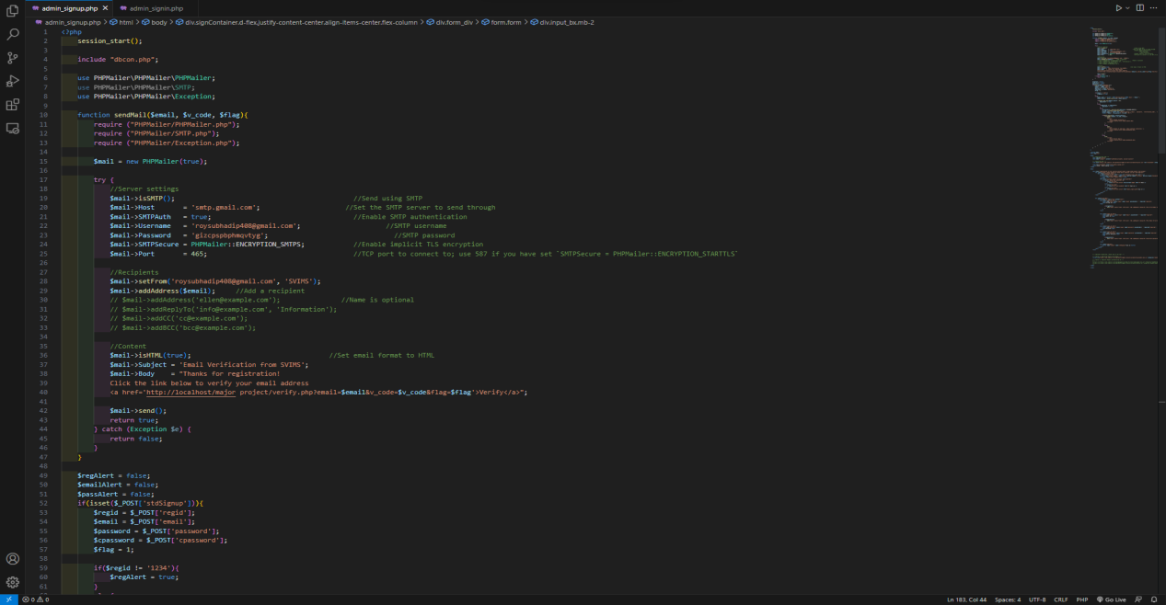
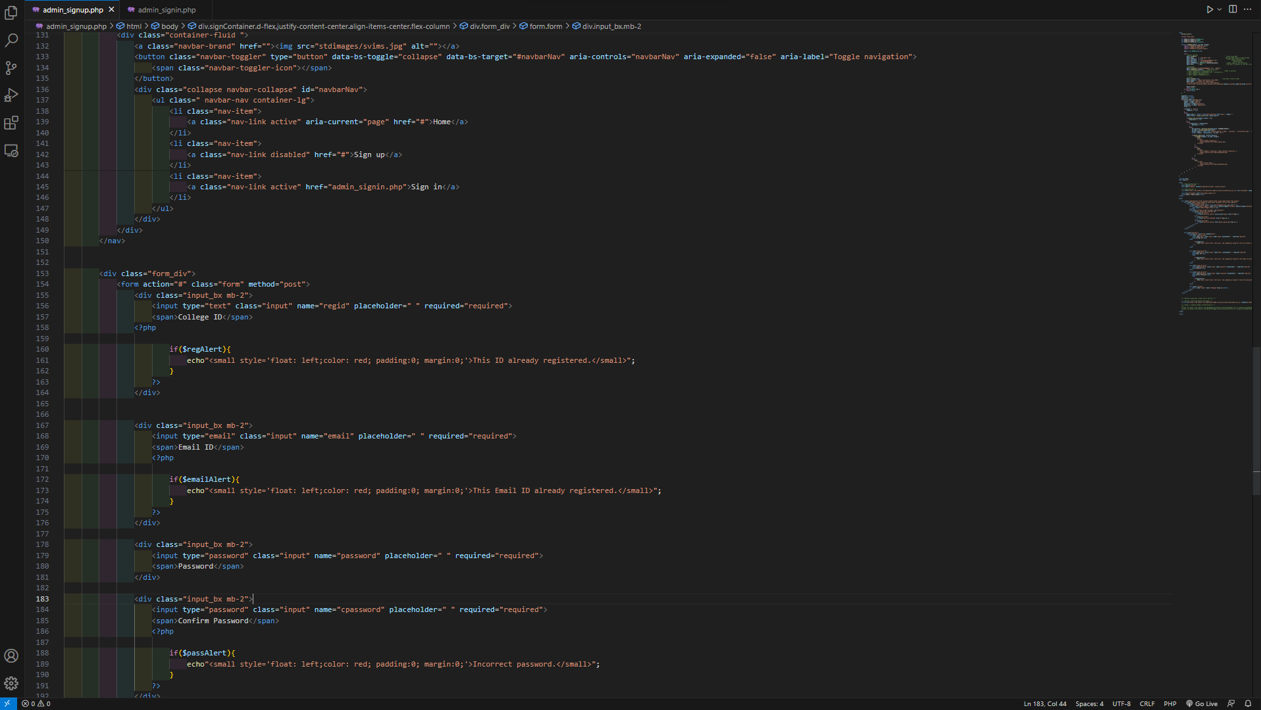
Admin Signup Page

Slide 12
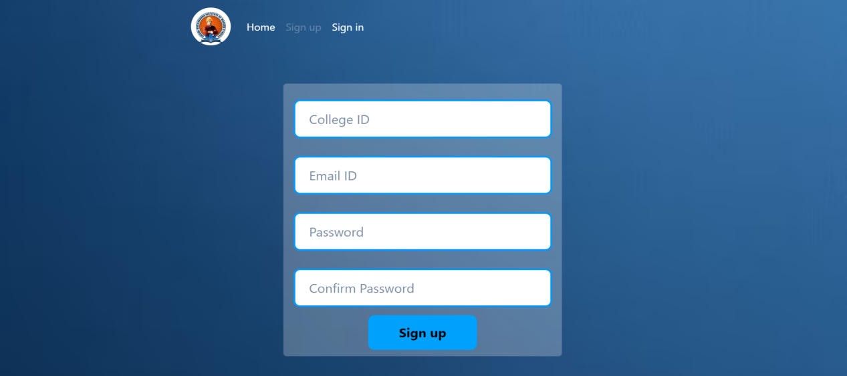
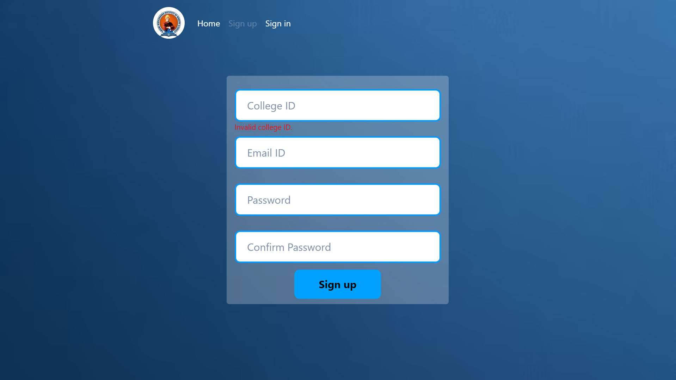
Admin Signup Page
New Administrator can fill up the form for registration and after successful registration they can use their email id and password to login into the application.
If not valid
New admin must write valid college code and email , password otherwise registration will not be done

Slide 13
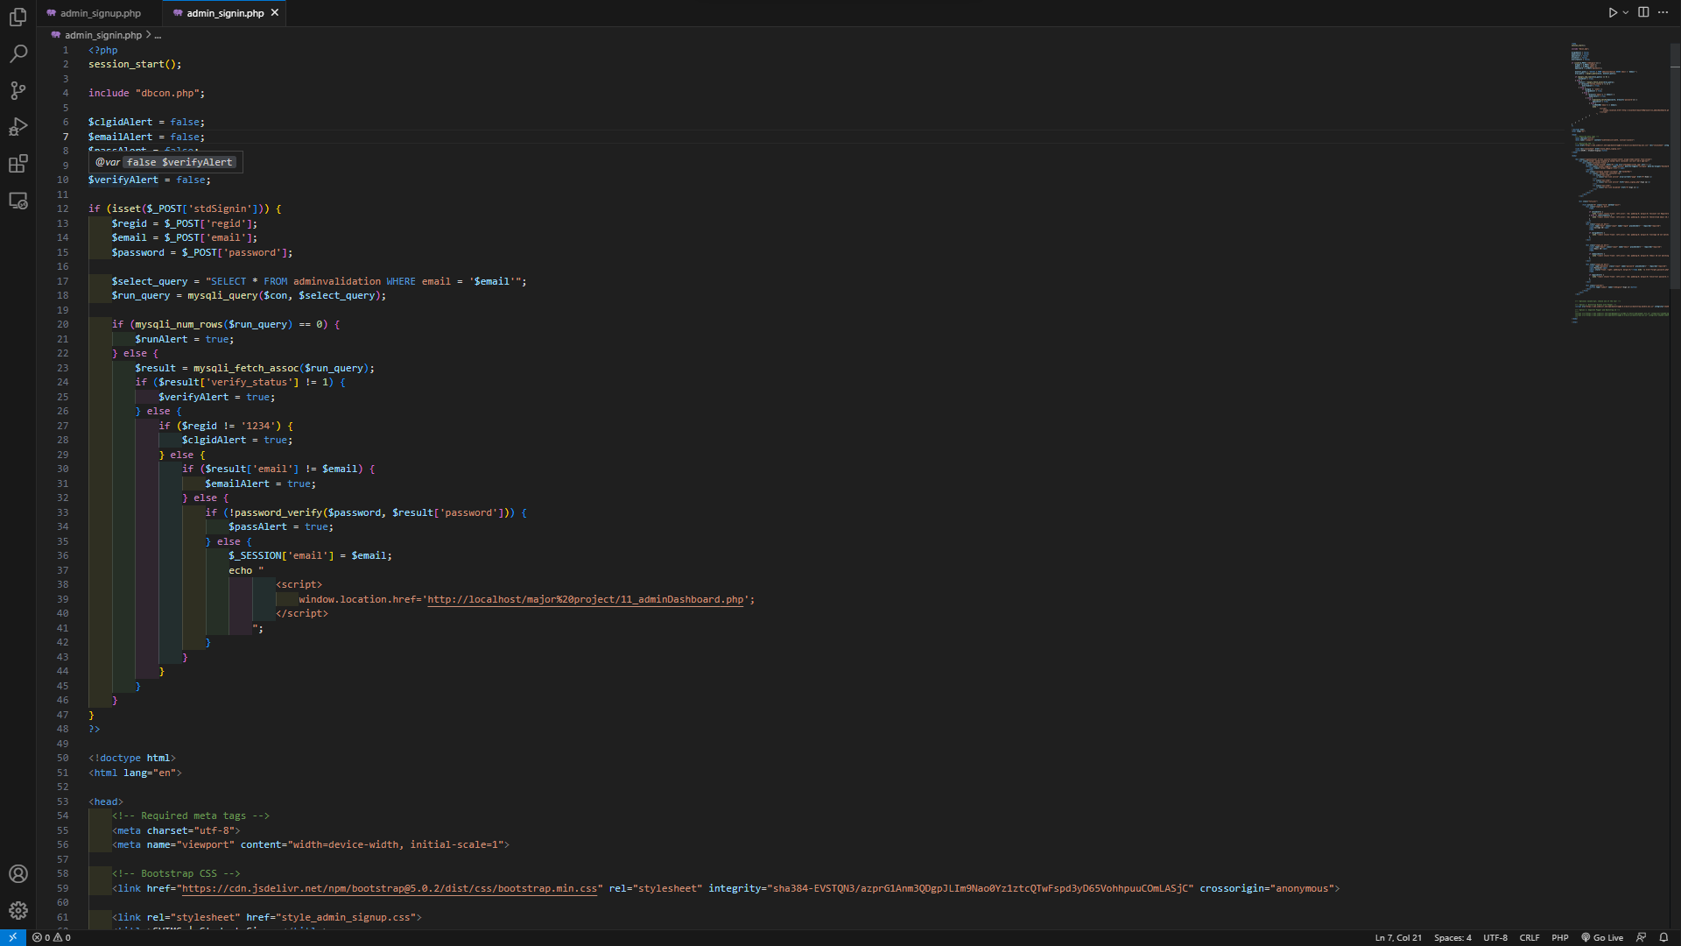
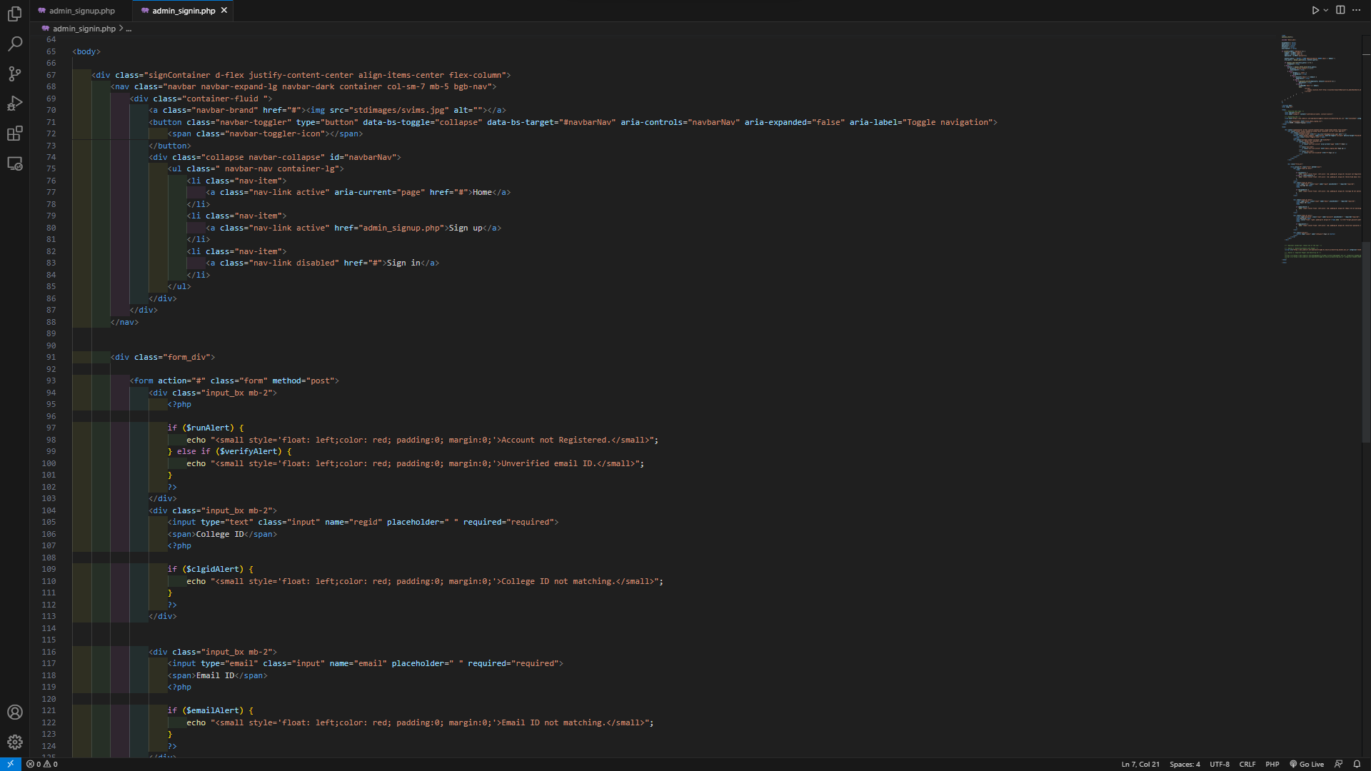
Admin Signin Page:

Slide 14
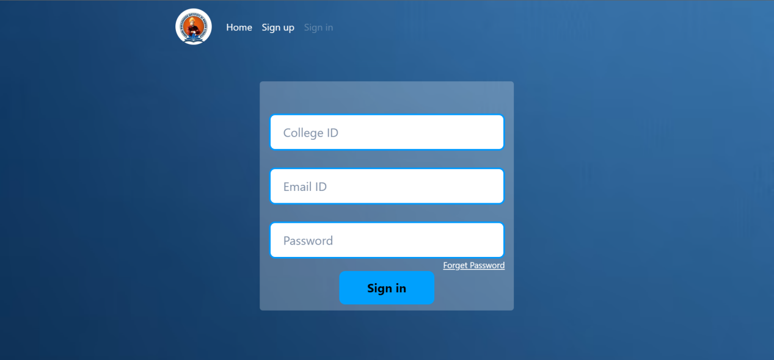
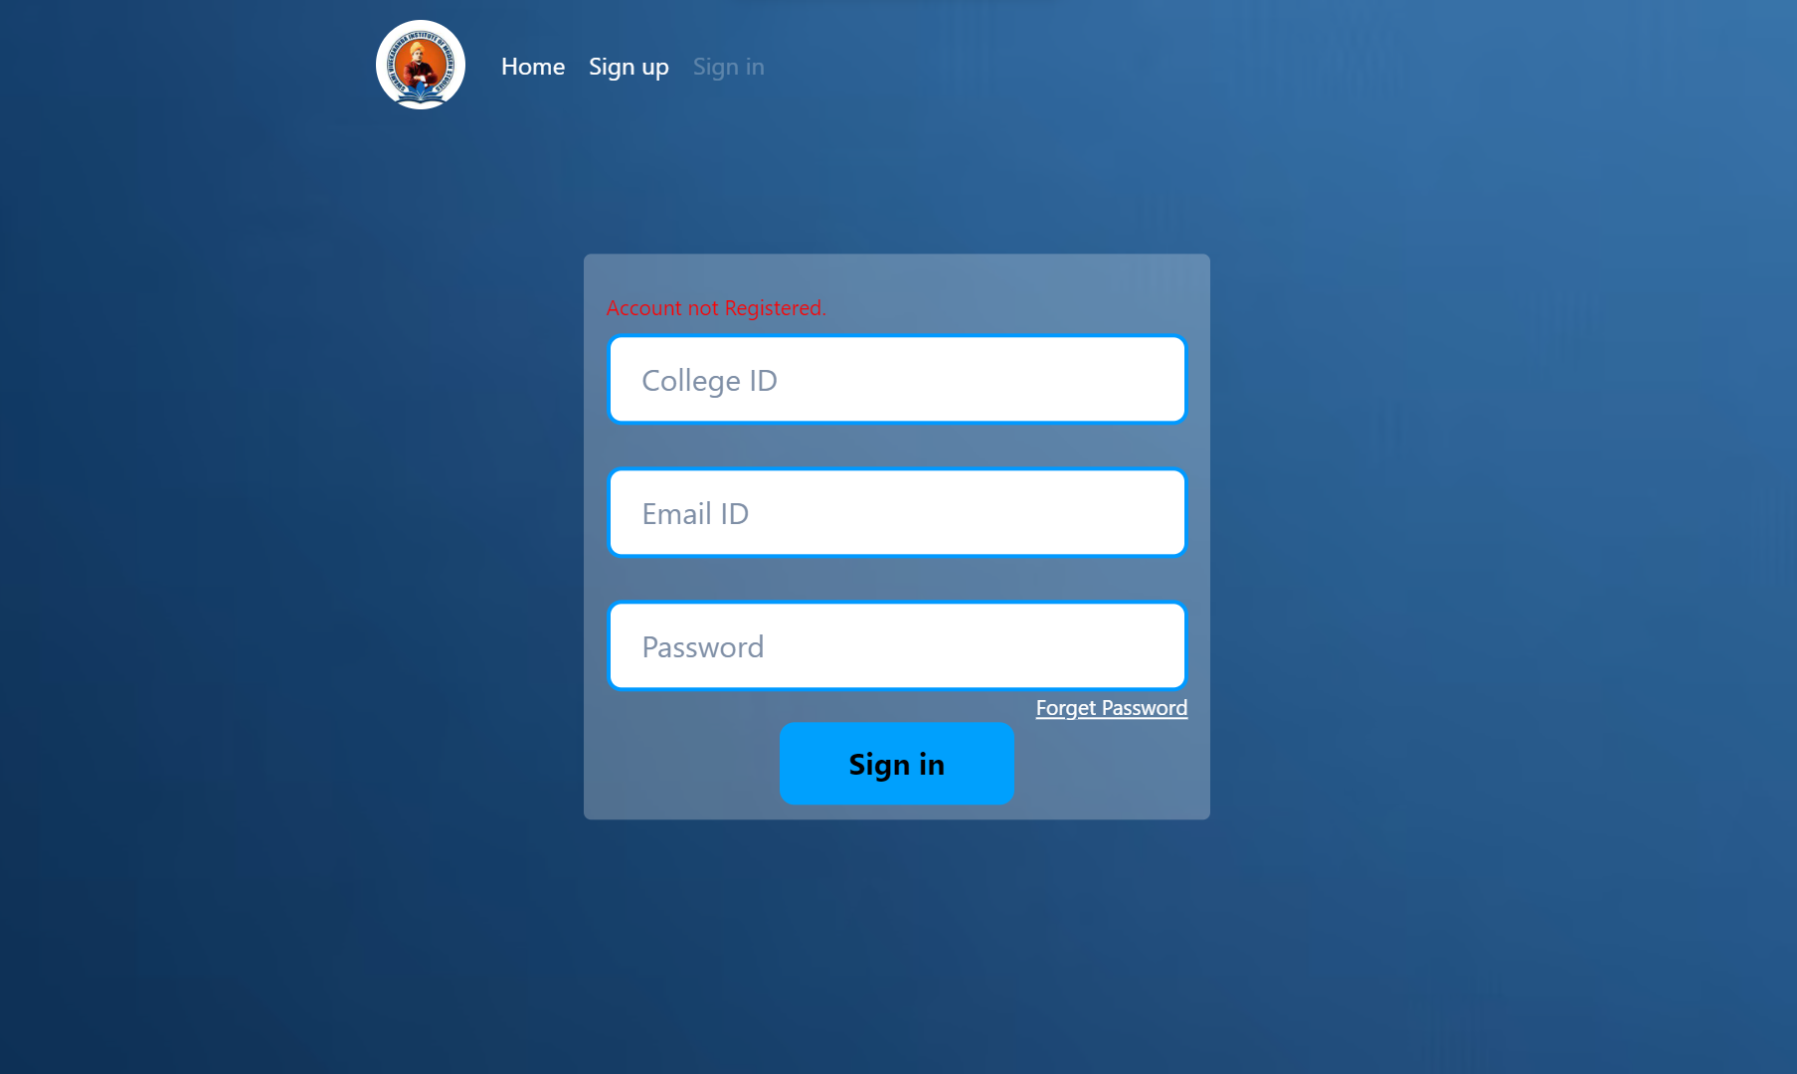
Admin Signin Page:
This is a login form where Admin can use their own email and password and college ID to login into the Dashboard.
If not valid
Admin have to write correct college ID , email and password to sign in to the admin dashboard otherwise login will be unsuccessful

Slide 15
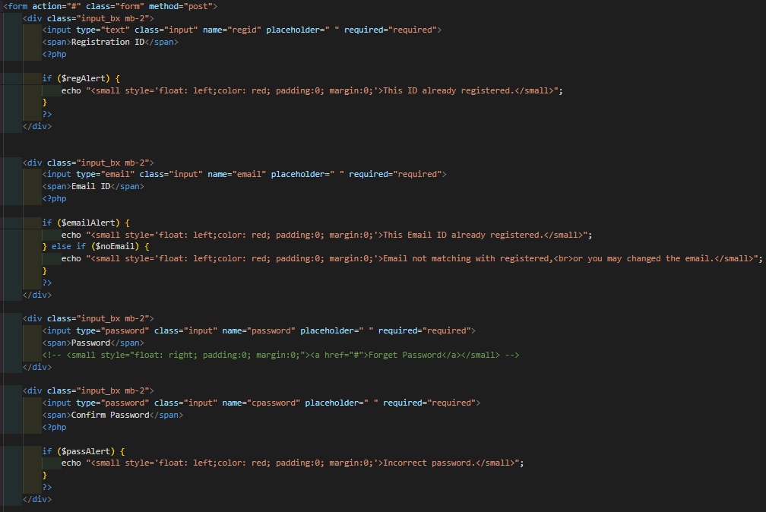
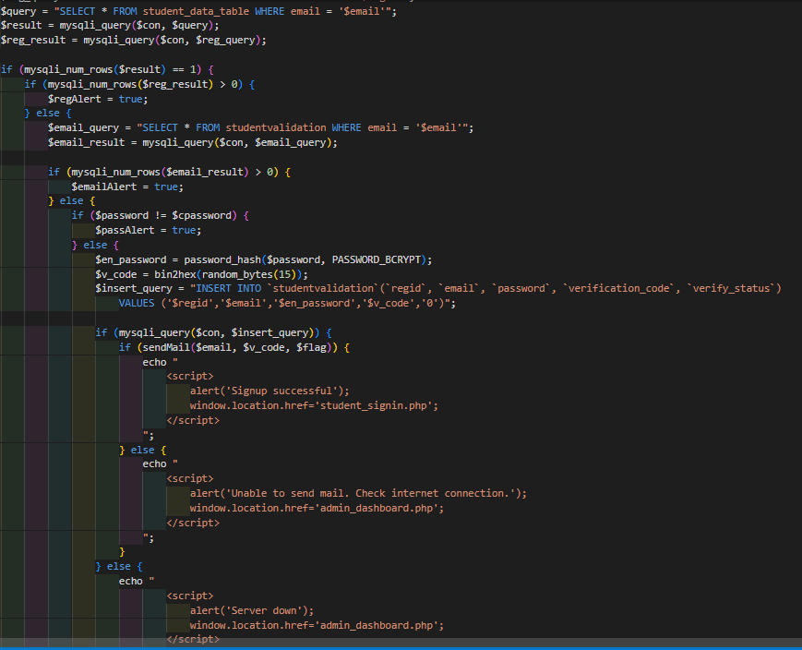
Student Signup Page

Slide 16
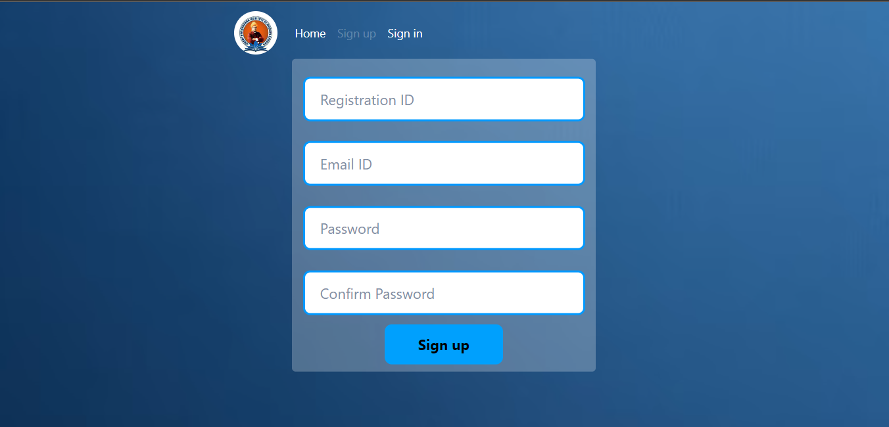
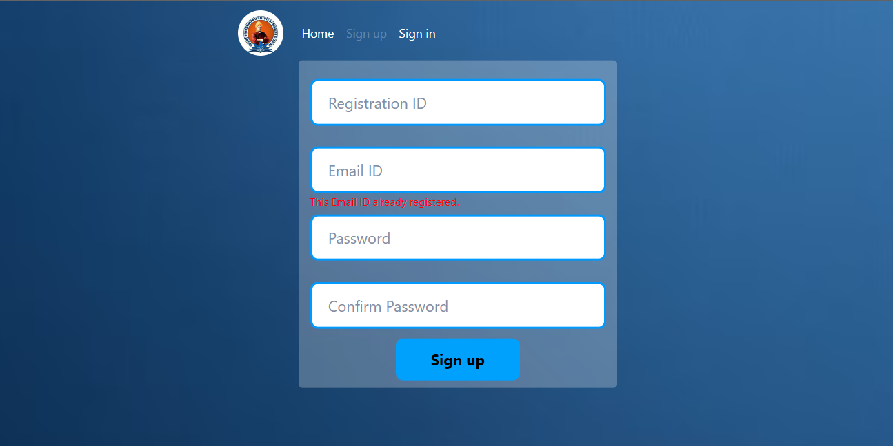
Student Signup Page
A student can fill up the form for registration and after successful registration they can use their email id and password to login into the application.
If not valid
New student must write valid registration ID and email , password otherwise registration will not be done

Slide 17
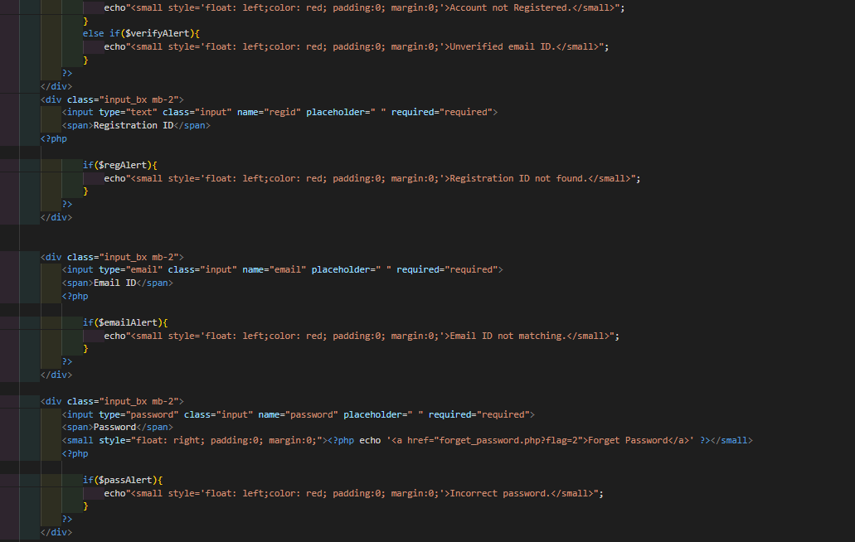
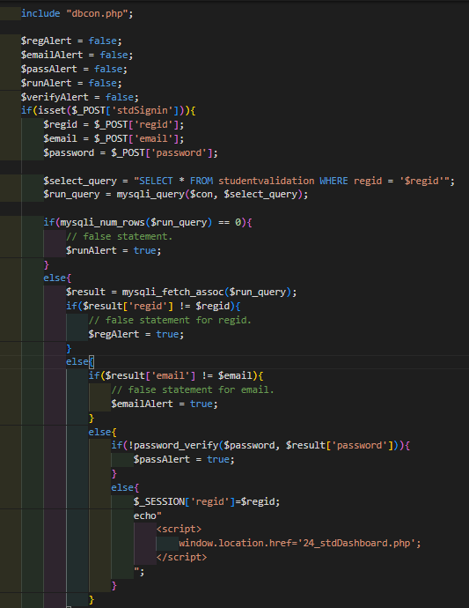
Student Signin Page:

Slide 18
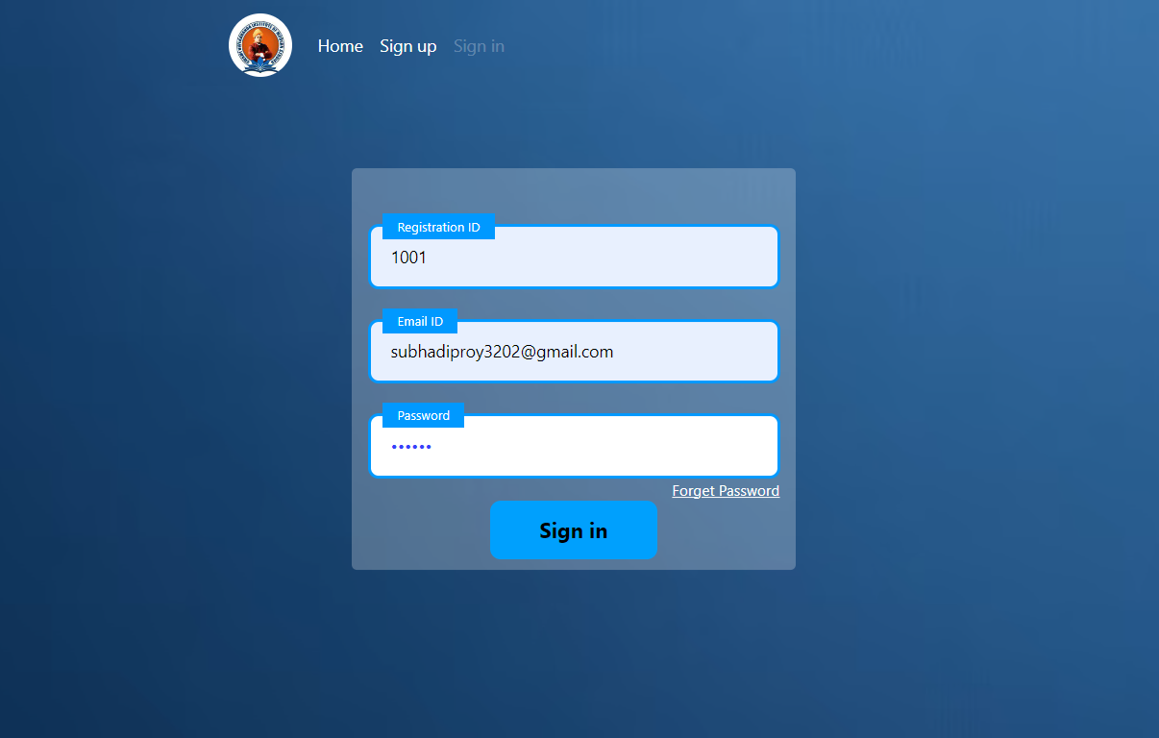
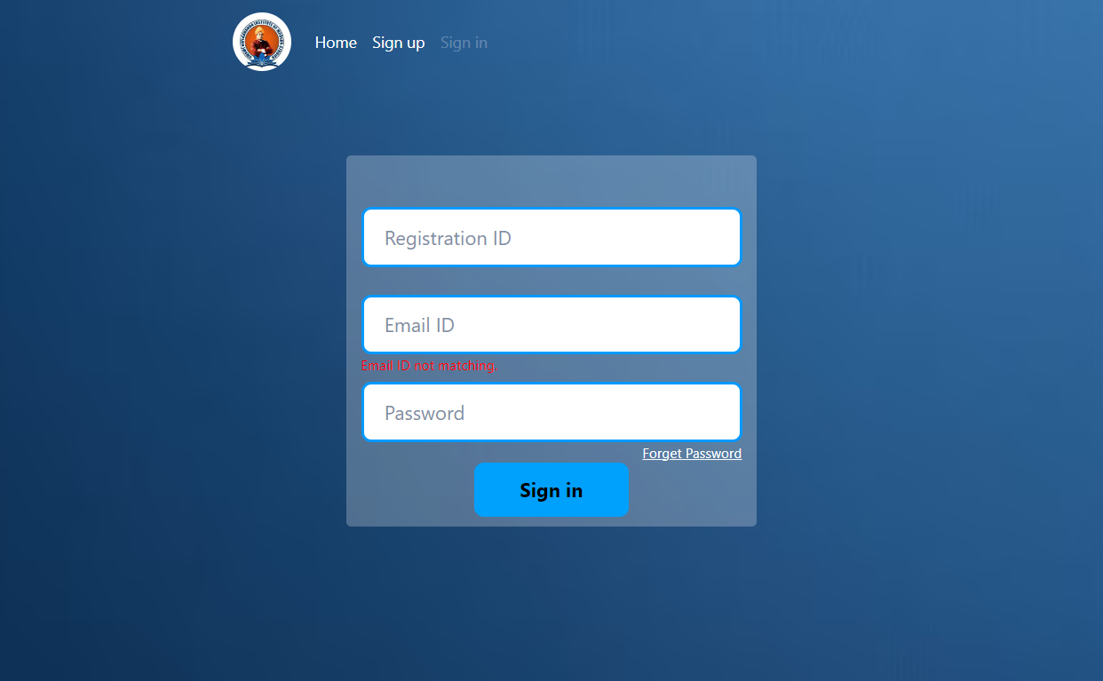
Student Signin Page:
This is a login form where Admin can use their own email and password and college ID to login into the Dashboard.
If not valid
student must fill the form with accurate reg id, email and passoword or he/she can’t sign in to the dashboard.

Slide 19
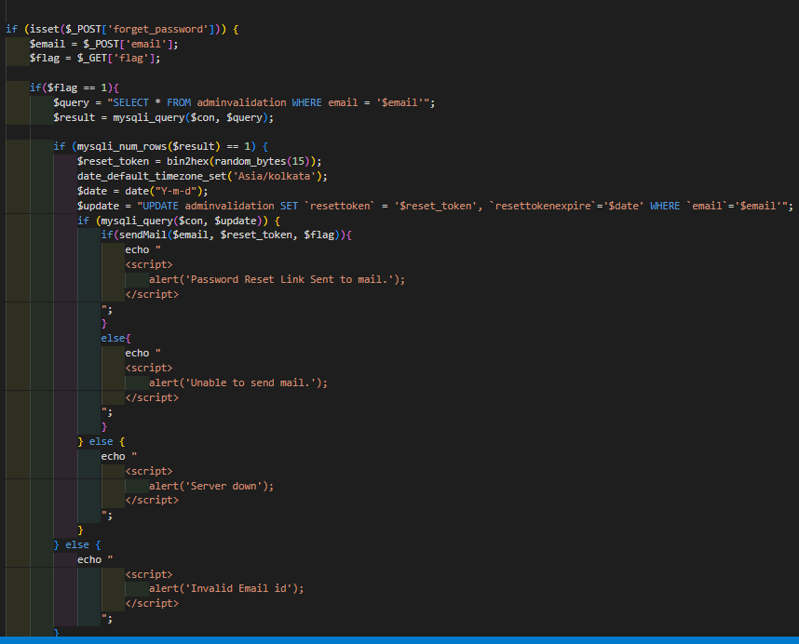
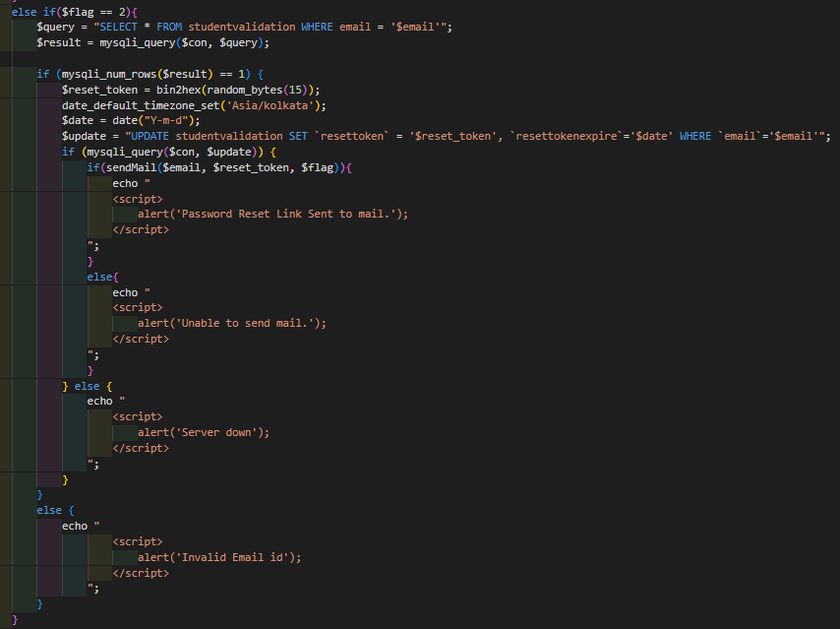
Forget Password

Slide 20
Admin Dashboard

Slide 21
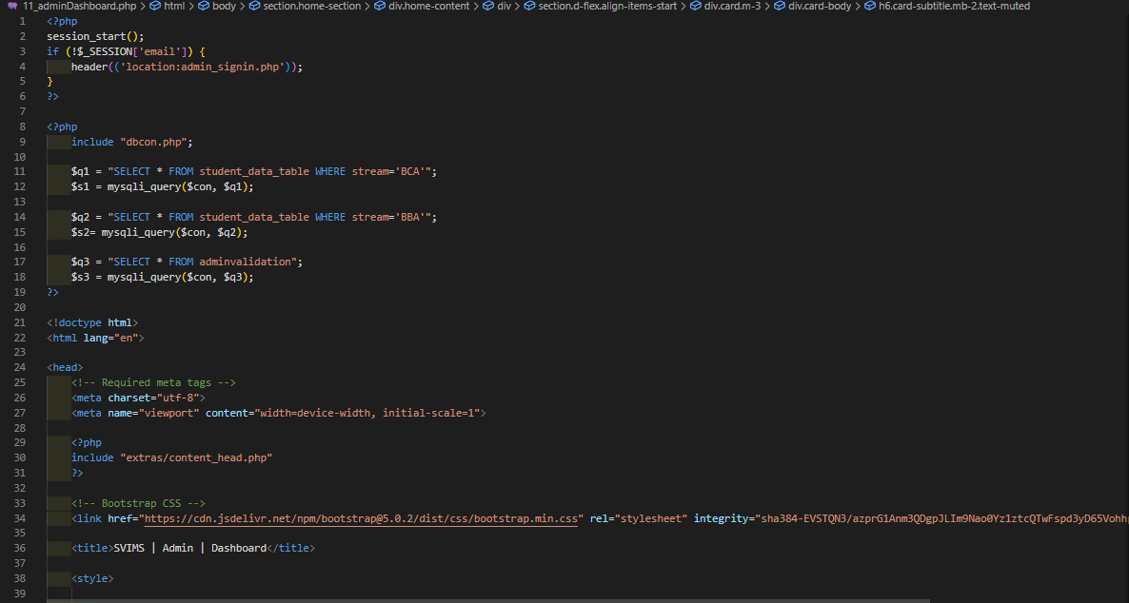
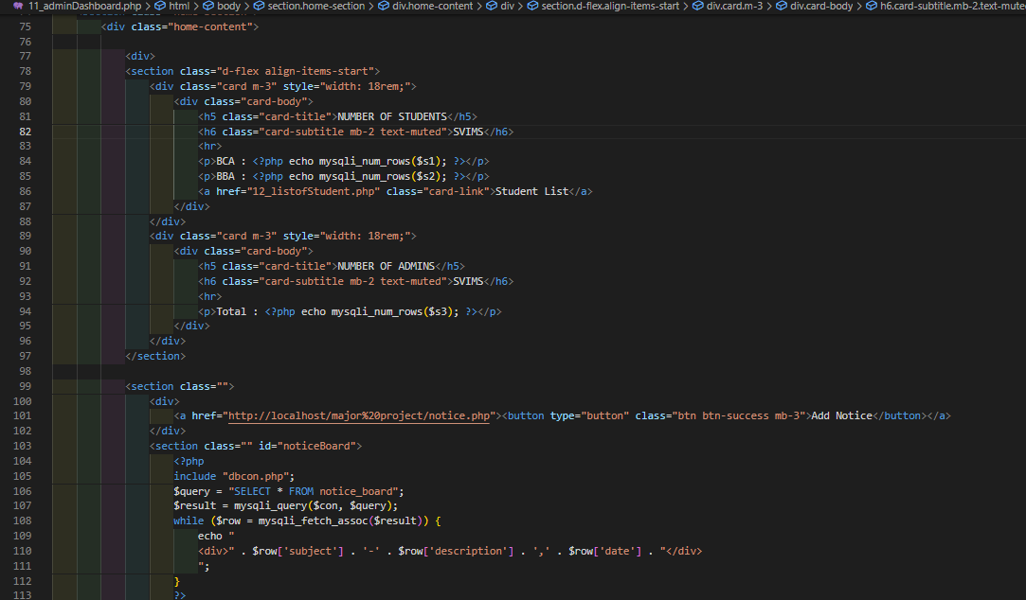
Dashboard:

Slide 22
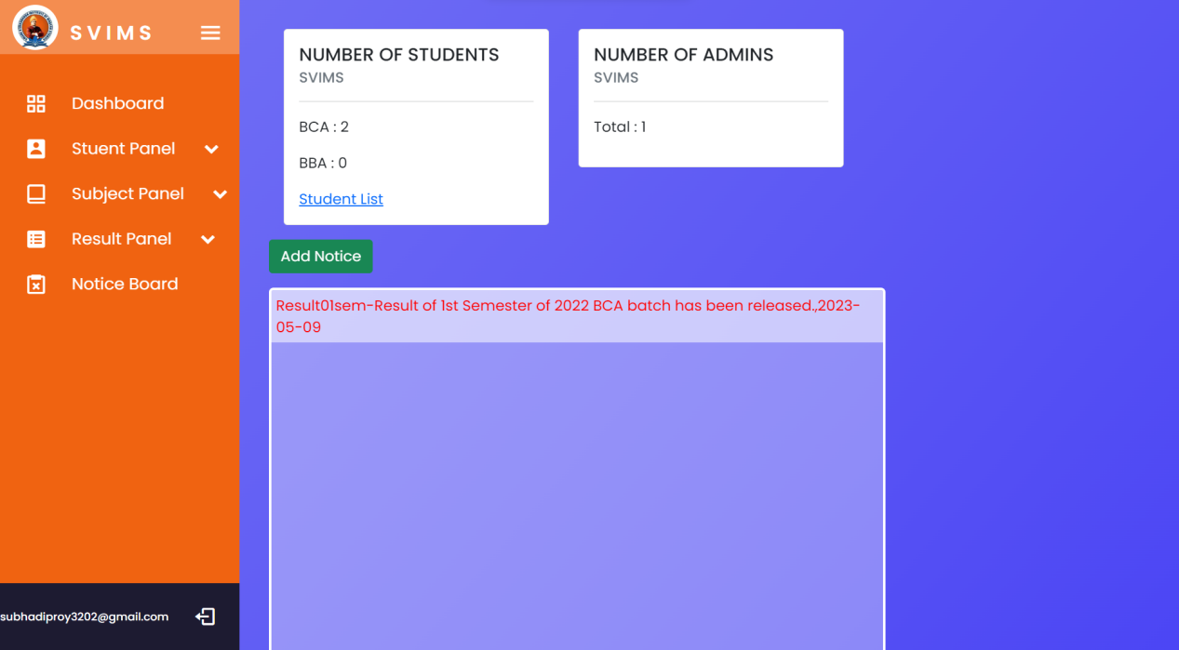
Dashboard:
Dashboard: This module displays overview of whole application such as number of Students, number of verified admin and notice board etc.

Slide 23
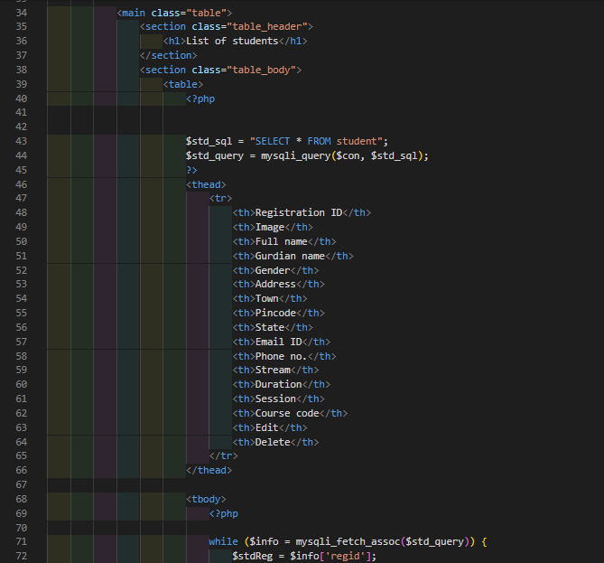
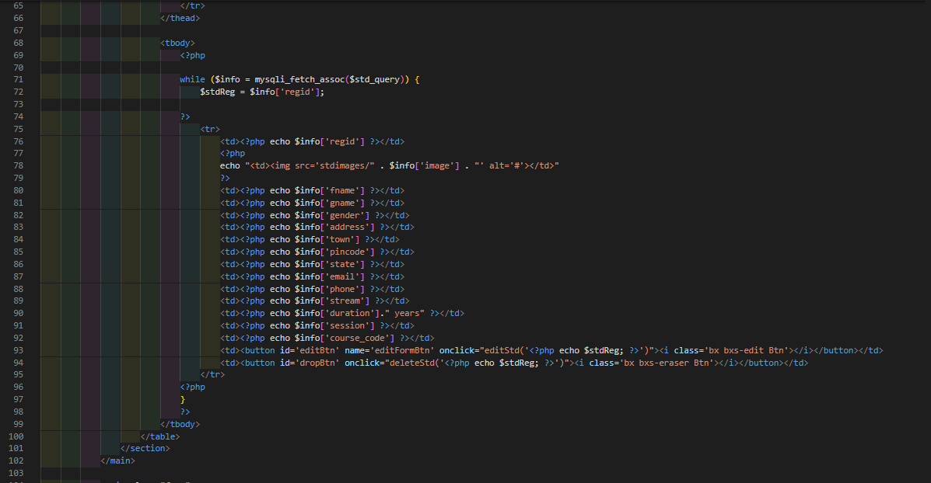
Admin Dashboard (Student Panel):
Student List: Source code

Slide 24
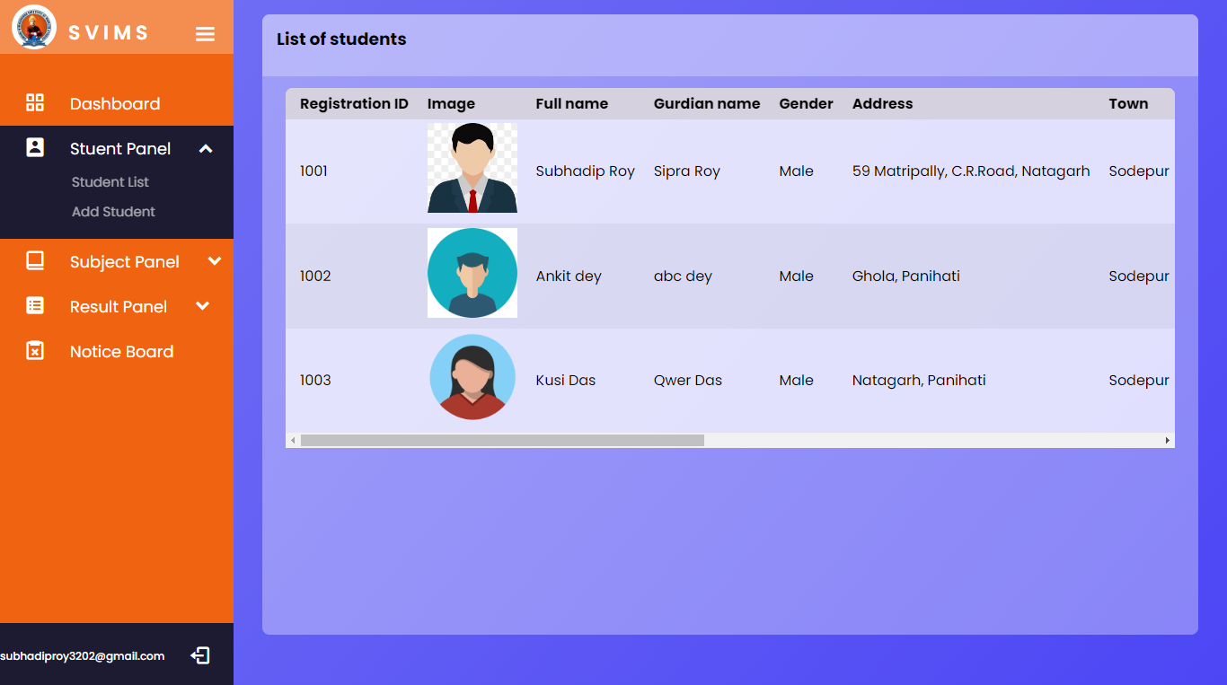
Student List:
This is one of the most important module of admin panel where Admin can view list of registered student as well as add edit or delete the registered student detatils.

Slide 25
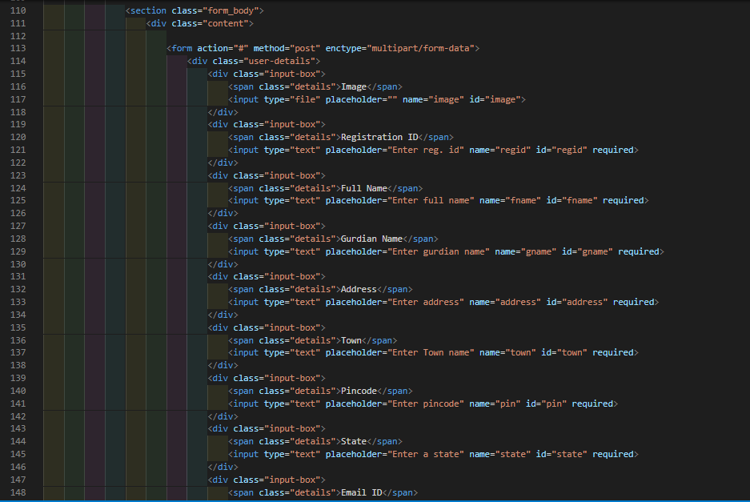
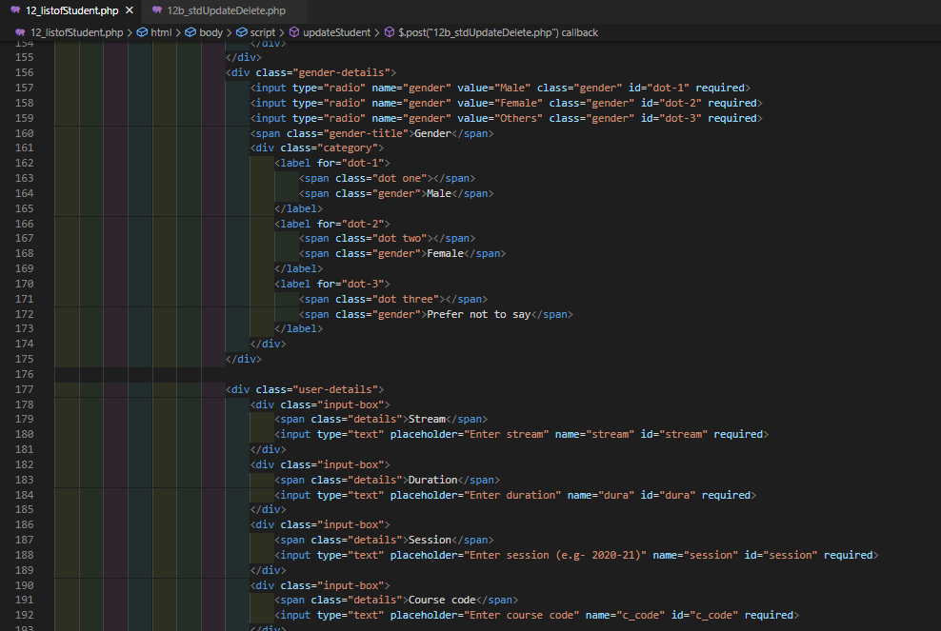
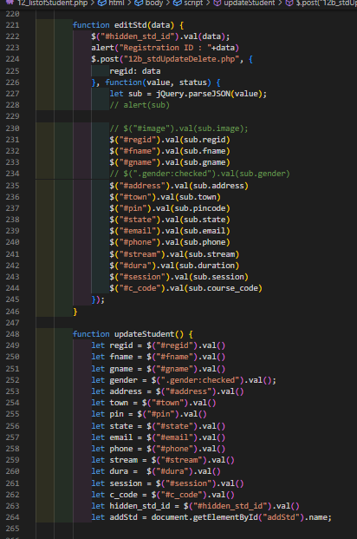
Edit student details: Source code

Slide 26
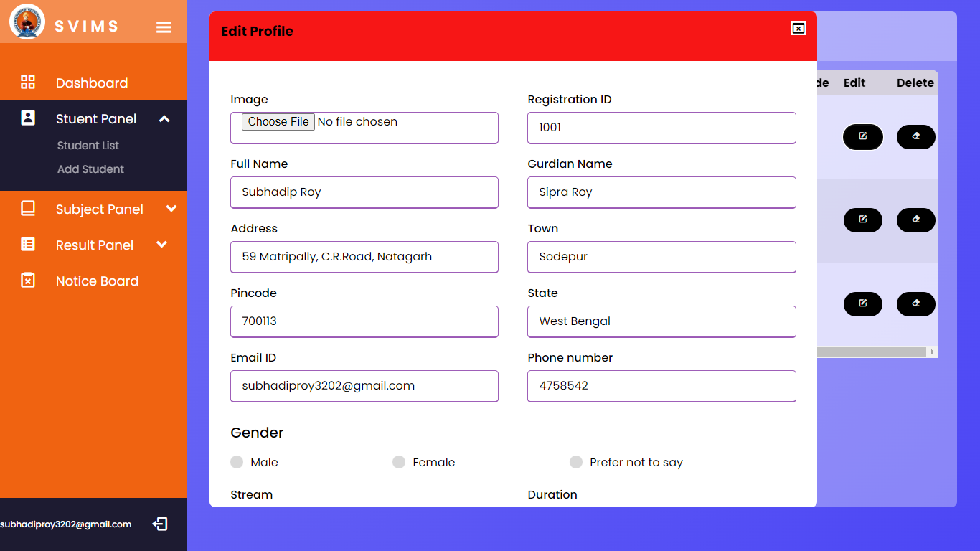
Edit student details:
Here an admin can edit a student details if admin makes any mistake(s) about the student.

Slide 27
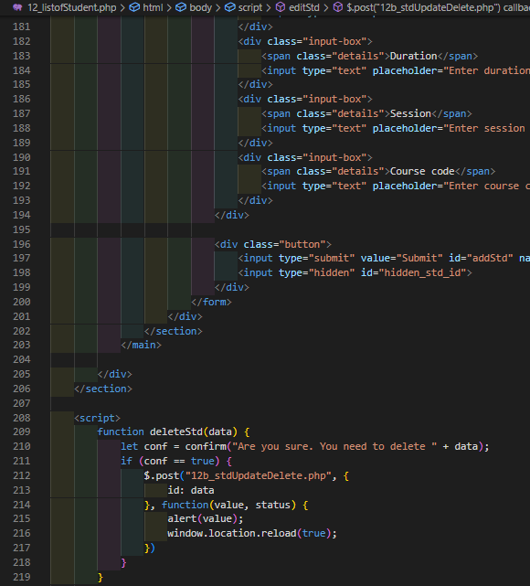
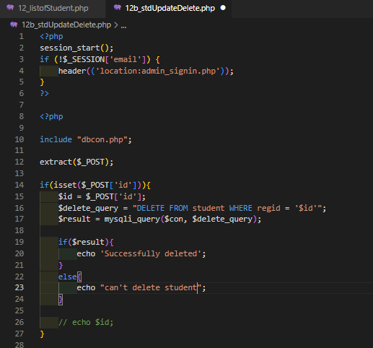
Delete student: Source code

Slide 28
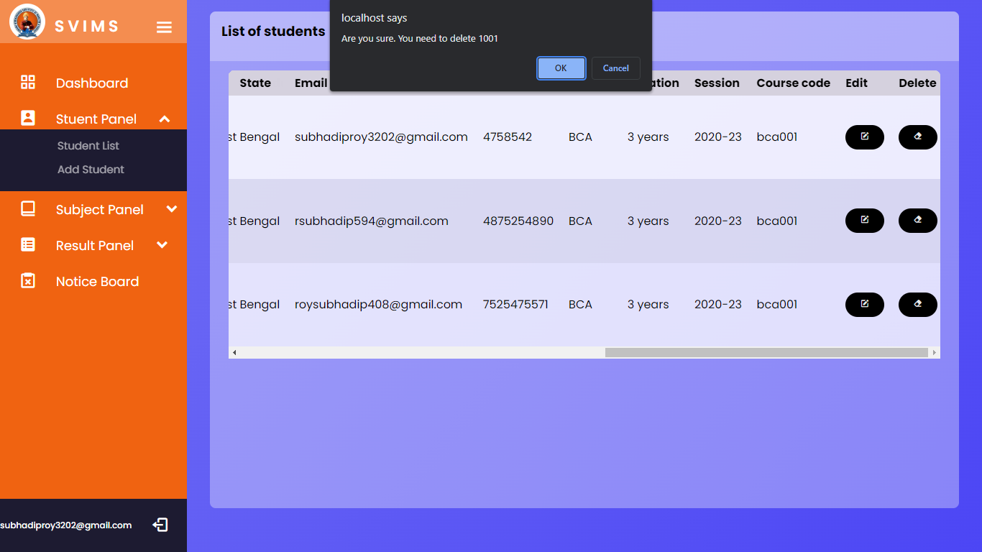
Delete student:
Clicking on the delete button will delete the selected student details from the student table.

Slide 29
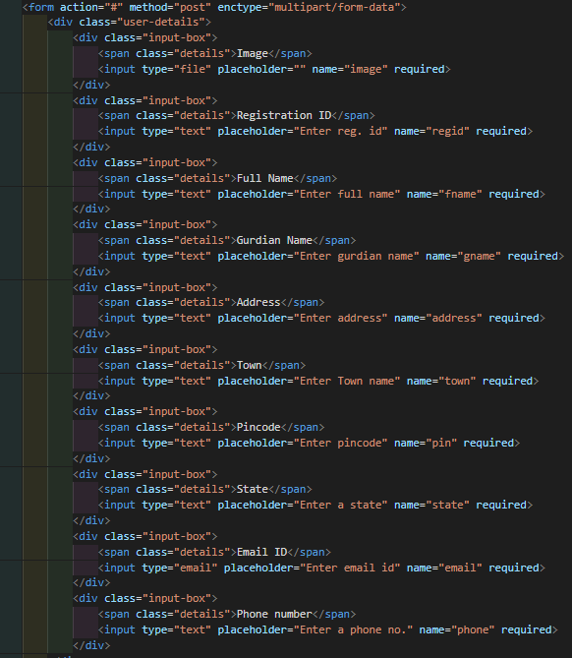
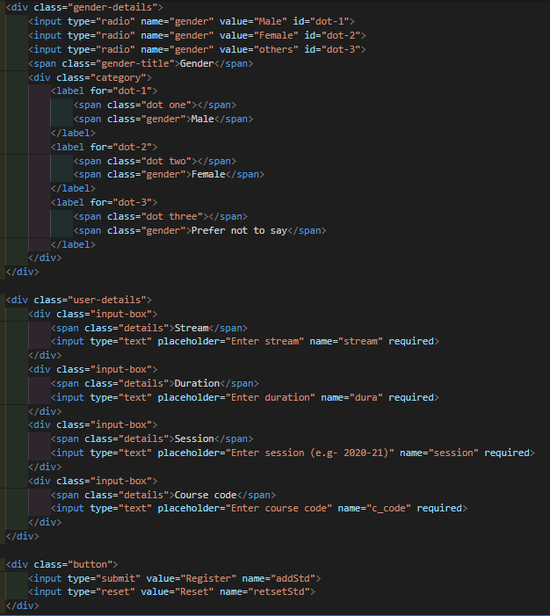
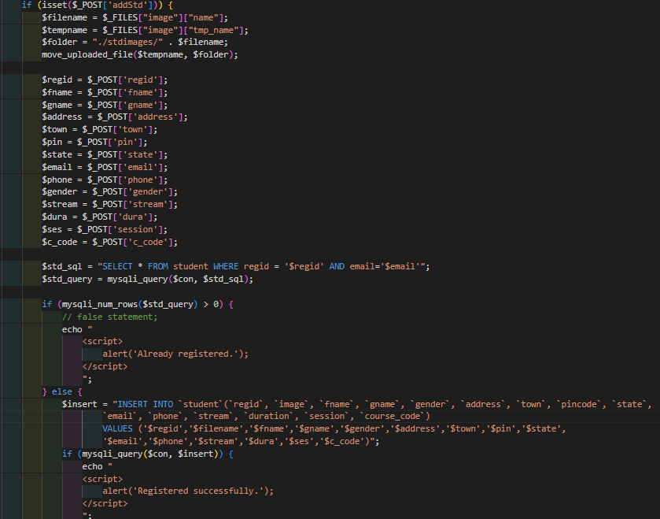
Admin Dashboard (Student Panel)
Add Student : Source code

Slide 30
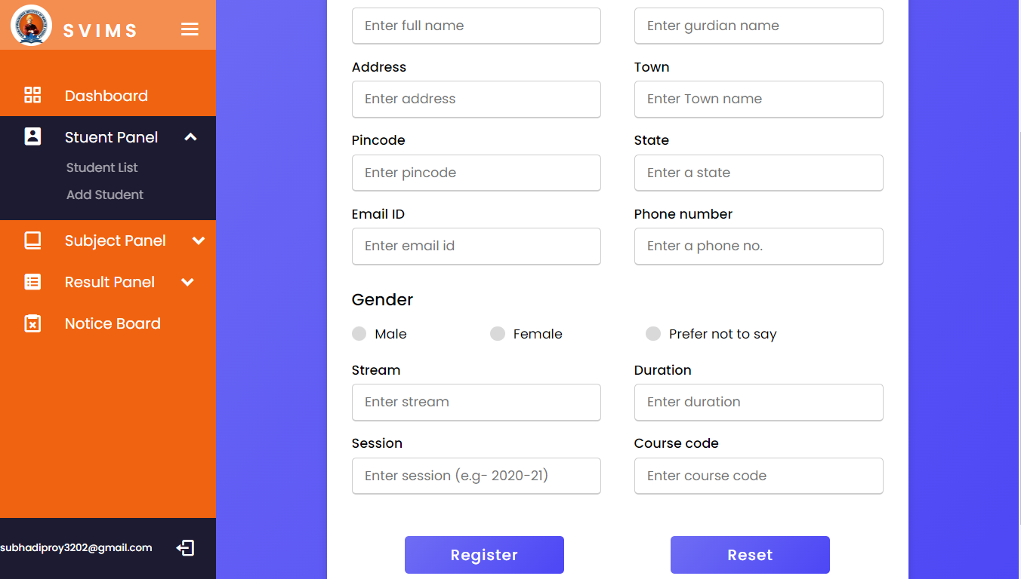
Add Student :
Admin can add a student by filling up the form with student details and click on register button to save the data on database.

Slide 31
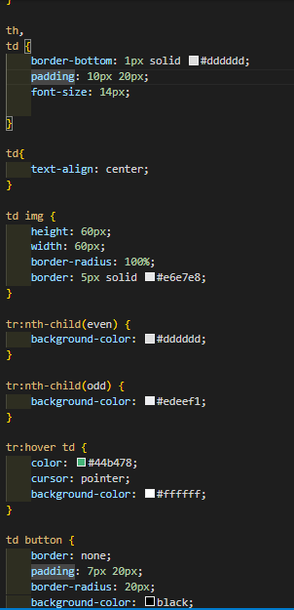
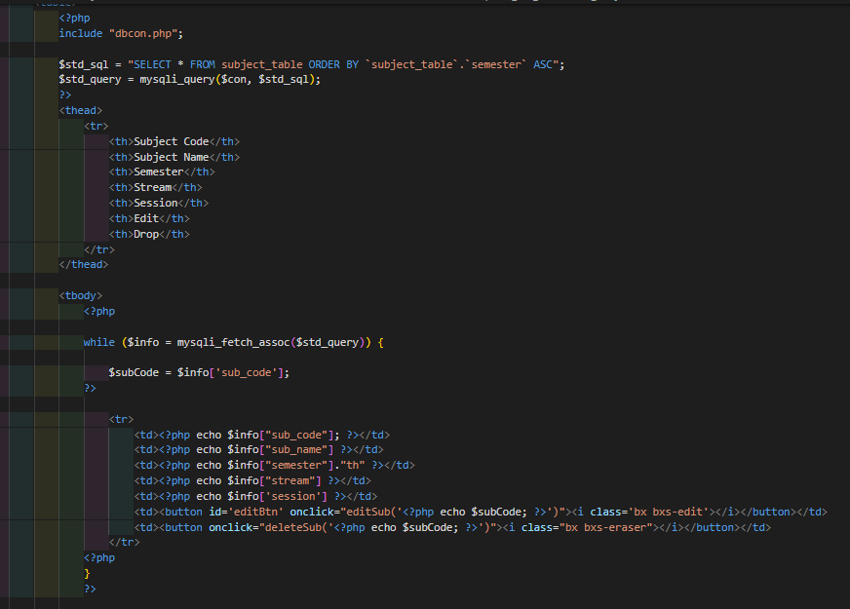
Admin Dashboard (Subject Panel)
List of subject: Source code

Slide 32
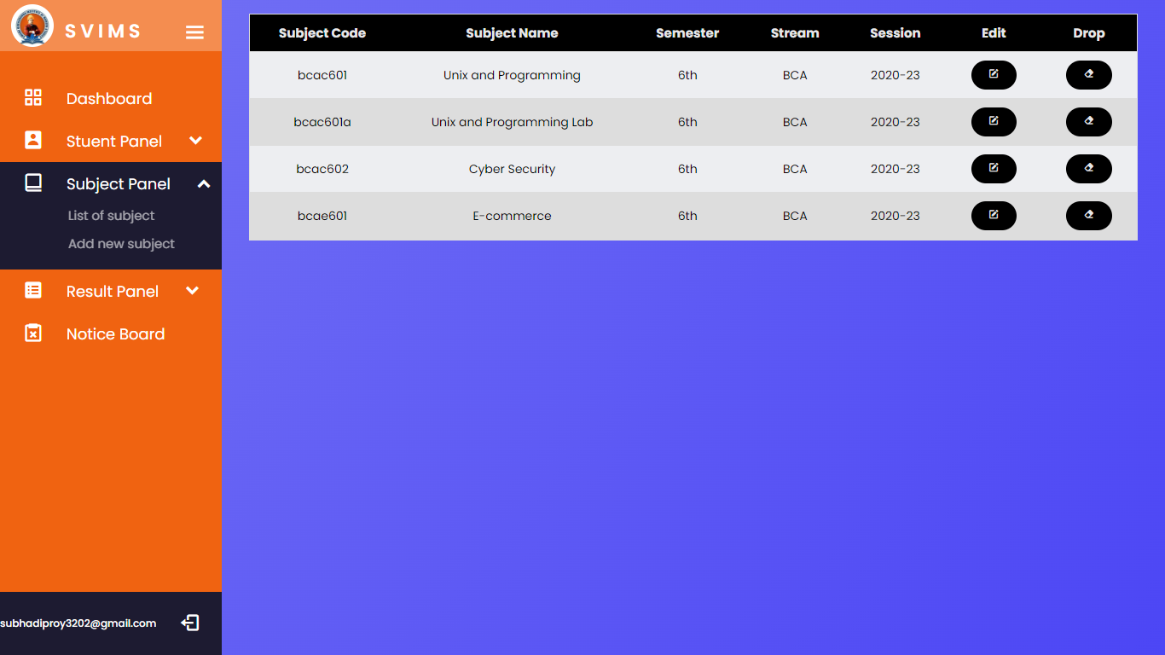
List of subject
In this page an admin can see all the subjects that are assigned in the past. Admin can delete and edit subject content too

Slide 33
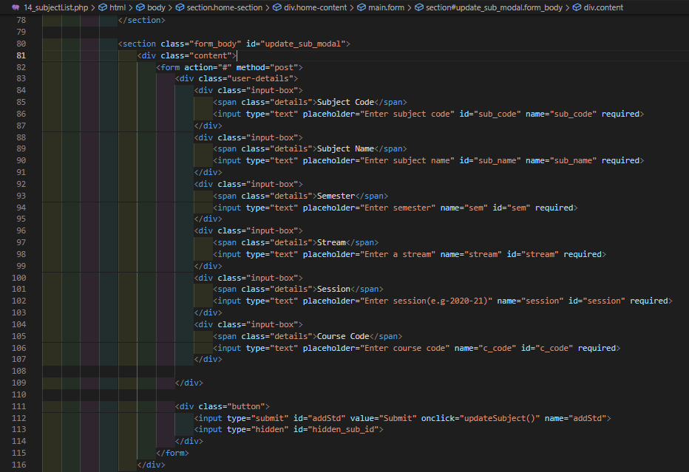
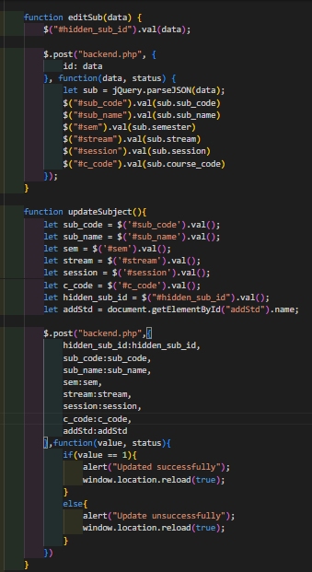
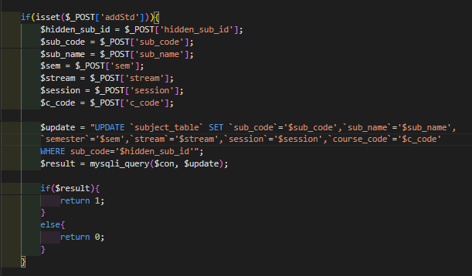
Edit subject: Source code

Slide 34
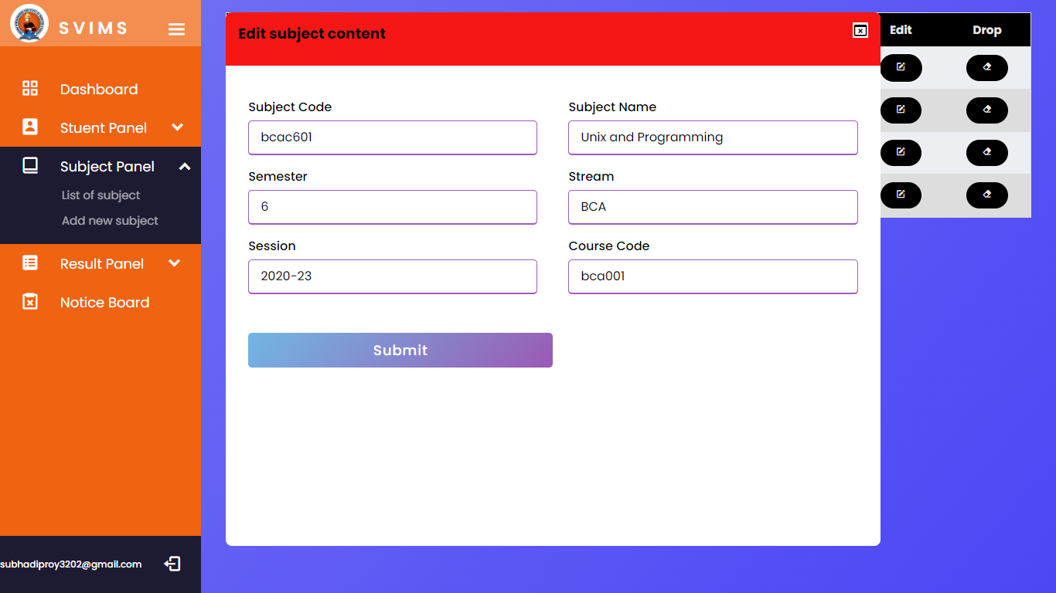
Edit subject:
Here an admin can edit a subject details if admin makes any mistake(s) about the subject.

Slide 35
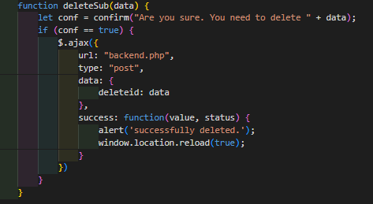
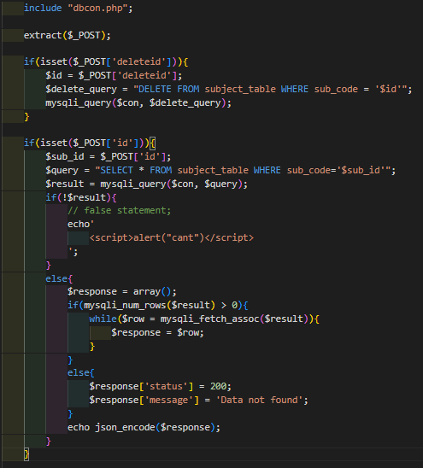
Delete subject: Source code

Slide 36
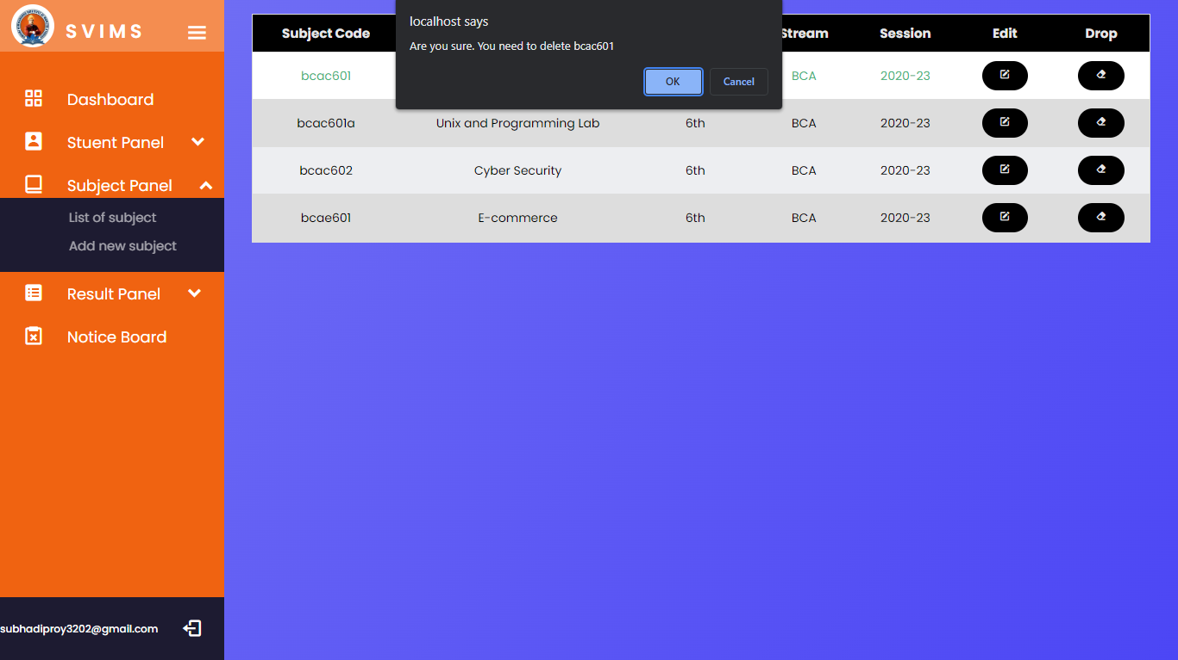
Delete subject:
Clicking on the delete button will delete the selected subject details from the subject table.

Slide 37
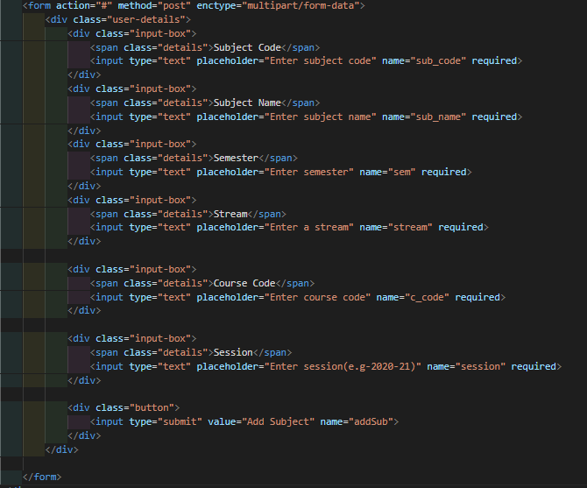
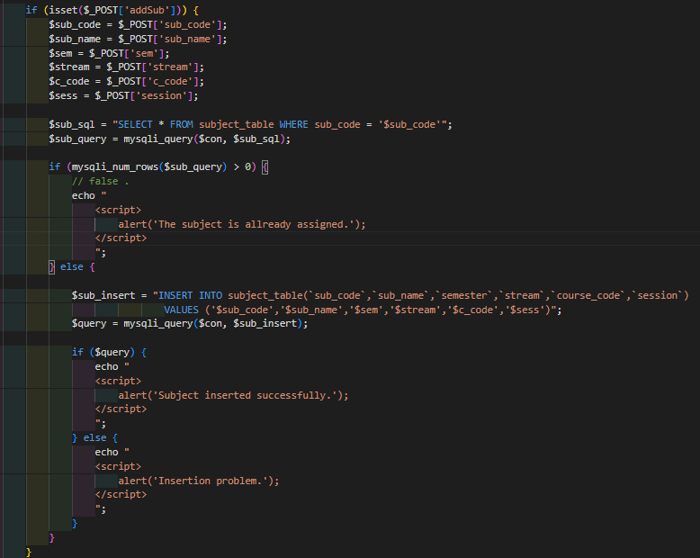
Admin Dashboard(Subject Panel)
Add new subject : Source code

Slide 38
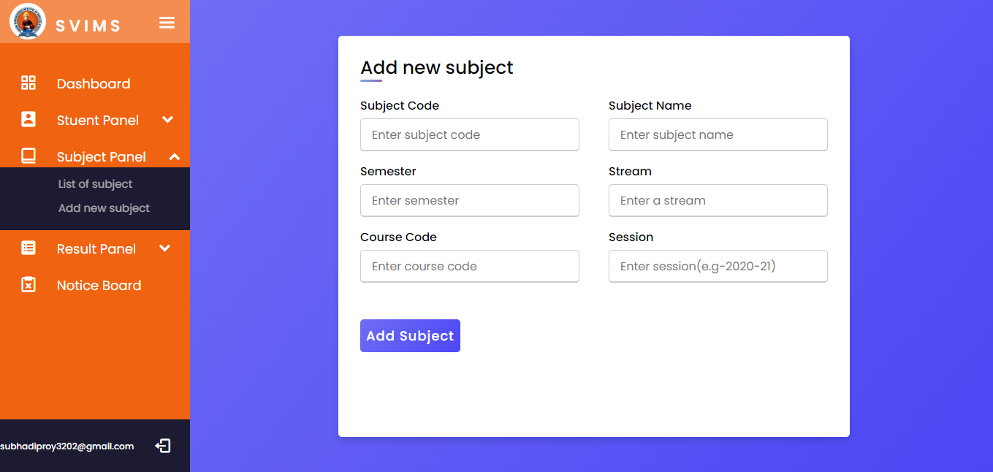
Add new subject
In this page admin can add new subject according to the institution need.

Slide 39


Admin Dashboard(Result Panel)
Result List : Source code

Slide 40

Result List
Here admin can see all the result listed that are assigned previously.

Slide 41


Edit Result : Source code

Slide 42

Edit Result
Here an admin can edit the result of a student if admin makes any mistake(s) or forget to input about the subject.

Slide 43


Admin Dashboard(Result Panel)
Add Result : Source code

Slide 44

Add Result :
In this page admin can assign new result to a particular student.

Slide 45


Admin Dashboard(Notice Board)
Notice Board : Source code

Slide 46

Notice Board :
From here admin can assign notice for the students.

Slide 47
Student Dashboard

Slide 48


Student Dashboard (Dashboard)
Source code & Webpage:

Slide 49



Student Dashboard(Profile)
Source code :

Slide 50

Profile :
By clicking on the profile link students can see their details registered in the database.

Slide 51


Edit Profile : Source code

Slide 52

Edit Profile
By clink edit button students can update their profile image as well as their email address.

Slide 53


Student Dashboard(Result)
Source code :

Slide 54

Result :
Here student can see the list of results semester wise.

Slide 55



View Result : Source code

Slide 56

View result
Students can see their provisional grade card and can download the grade card for future use.

Slide 57
DataBase
DataBase Name : student_record_database

Slide 58


Table name : adminvalidation

Slide 59


Table name : studentvalidation

Slide 60


Table name : student

Slide 61


Table name : subject_table

Slide 62


Table name : enrollment

Slide 63


Table name : notice_board

Slide 64

Data Flow Diagram(DFD):
DFD 0 Level Context Level Diagram:
The 0 Level DFD shows flow of data of application. DFD Level 0 is also called a Context Diagram. It’s a basic overview of the whole system or process being analyzed or modeled.

Slide 65

DFD Level 1 Diagram:

Slide 66
DFD Level 2 Diagram:
Authentic Status
Authentic Status
update retrieve update retrieve
Student subject_table
Admin/Student Authentic Status
Authentic Status Authentic Status add
student
view submit view assign
notice_board enrollment
Admin
Update
Student Profile
Upload
Subject
Authentication
Add student
Student
notice
result

Slide 67

E.R. DIAGRAM

Slide 68
FUTURE SCOPE
The Student Record System(SRS) can be enhanced to include some other functionality in the attendance section and other areas.
Talent management of students based on their performance evaluationcan be added.
Online class functionality can be added.
Online exam functionality can be added.

Slide 69
CONCLUSION
The Student Record System has been computed successfully and was also tested successfully by taking "Test Cases". It is user friendly, and has required options, which can be utilized by the user to perform the desired operations.
The goals that are achieved by the Website are:
Simplification of the operations
Less processing time and getting required information
User friendly
Portable and flexible for further enhancement

Slide 70


